Slide 1
Cloud Computing: SOAP based Web Services
Vijay Dialani, PhD
Boise State University
vijaydialani@boisestate.edu
©All rights reserved by the author

Slide 2
Cloud Computing – Examples for this Lecture
https://github.com/vdialani/CloudComputing.git
Look for examples in “chapter2” folder of this repository.

Slide 3
Cloud Computing – SOAP
What is SOAP?
SOAP (Simple Object Access Protocol) is a lightweight protocol for exchange of objects between services in a distributed system. SOAP uses XML to define an extensible, interoperable and programming model independent format for passing one-way messages between systems.
SOAP has three major characteristics:
Extensibility: Security and WS-routing are among the extensions under development
Neutrality: SOAP can be used over any transport protocol such as HTTP, SMTP, TCP, UDP, or JMS and
Independence , SOAP allows for any programming model.

Slide 4
Why SOAP?
WSDL specifies the interface for the web service. Once the object has been serialized it needs to be marshaled/routed across the network from a sender to the receiver.
When the message is being routed on the network, it may require:
secure transport
multi-cast capability
guaranteed delivery
callback handling
SOAP facilitates all of the above mentioned properties of message routing across the networks.
A SOAP message is composed of three sub-parts (more discussion on this latter.)
A SOAP Envelope
A SOAP Header
A SOAP Body
SOAP messages allow encryption of the body and the header and the communication between the sender and receiver could be routed through the information in the Envelope.

Slide 5
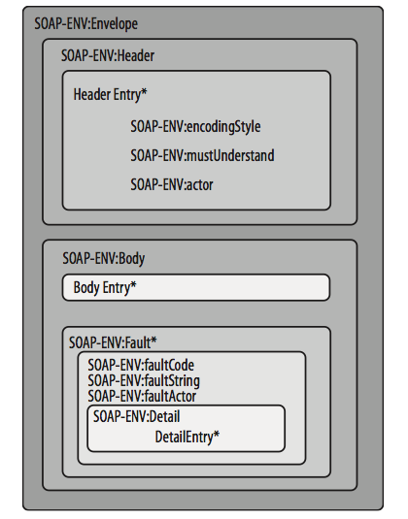
Structure of a SOAP message
Example SOAP Message
POST /InStock HTTP/1.1
Host: www.example.org
Content-Type: application/soap+xml; charset=utf-8
Content-Length: 299
SOAPAction: "http://www.w3.org/2003/05/soap-envelope"
<?xml version="1.0"?>
<soap:Envelope
xmlns:soap="http://www.w3.org/2003/05/soap-envelope">
<soap:Header>
</soap:Header>
<soap:Body>
<m:GetStockPrice
xmlns:m="http://www.example.org/stock">
<m:StockName>IBM</m:StockName>
</m:GetStockPrice>
</soap:Body>
</soap:Envelope>

Slide 6
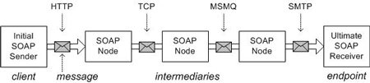
SOAP: Interoperability

Slide 7
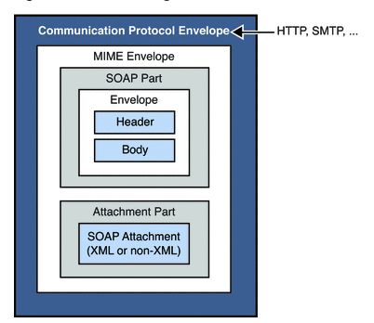
SOAP: MIME messages
SOAP can be used to transmit Binary Large OBjects (BLOBs).
Such BLOBs are wrapped in the MIME message envelope used by SMTP and other protocols
The multipart message will contain the usual SOAP object and could also have parts of the messages encoded for security reasons.

Slide 8
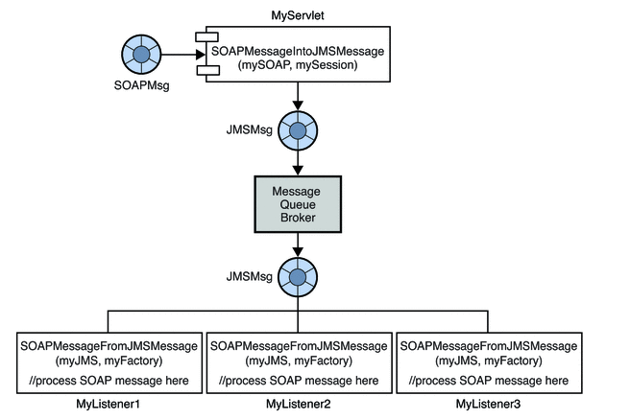
SOAP Multicast

Slide 9
Simple SOAP Service
Let us walk through the example on git.

Slide 10
WS-Security
WS-Security describes three main mechanisms:
How to sign SOAP messages to assure integrity. Signed messages also provide non-repudiation?
How to encrypt SOAP messages to assure confidentiality?
How to attach security tokens to ascertain the sender's identity?
The specification allows a variety of signature formats, encryption algorithms and multiple trust domains, and is open to various security token models, such as:
X.509 certificates,
Kerberos tickets,
UserID/Password credentials,
SAML Assertions, and
custom-defined tokens.

Slide 11
SOAP: Security Alternatives
Security Specification
WS-Security
XML Signature
XML Encryption
XML Key Management (XKMS)
WS-SecureConversation
WS-SecurityPolicy
WS-Trust
WS-Federation
WS-Federation Active Requestor Profile
WS-Federation Passive Requestor Profile
Web Services Security Kerberos Binding
Web Single Sign-On Interoperability Profile
Web Single Sign-On Metadata Exchange Protocol
Security Assertion Markup Language (SAML)
XACML

Slide 12
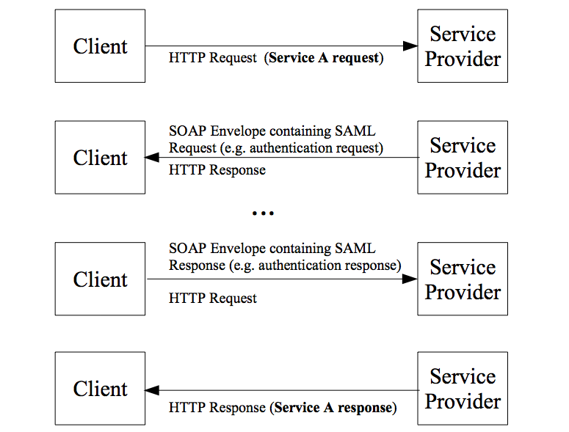
Security example – SAML over SOAP

Slide 13
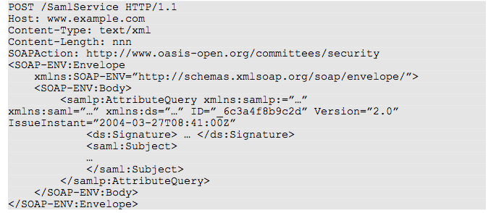
Security example – SAML over SOAP -I

Slide 14
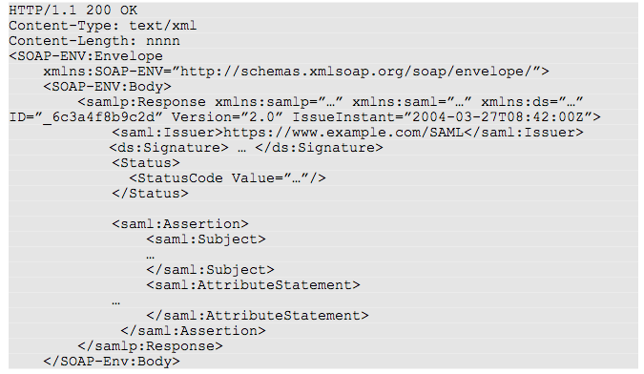
Security example – SAML over SOAP -II

Slide 15
Quiz
Classroom exercise

Slide 16
SOAP – messaging specifications
SOAP Message Transmission Optimization Mechanism
WS-Notification
WS-BaseNotification
WS-Topics
WS-BrokeredNotification
WS-Addressing
WS-Transfer
WS-Eventing
There are numerous messaging protocols, many are to do with the possible
ways of transmitting the messages in async message queue frameworks.
Here we will be focusing on WS-Addressing

Slide 17
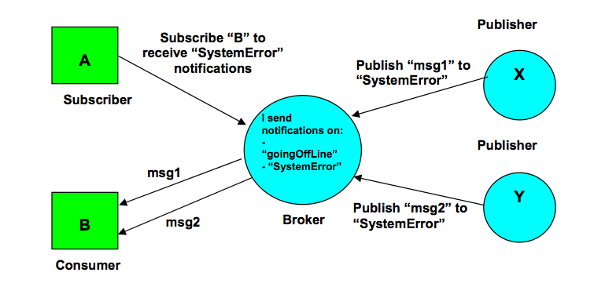
SOAP – WS-Notification
http://www.ibm.com/developerworks/library/ws-pubsub/WS-PubSub.pdf

Slide 18
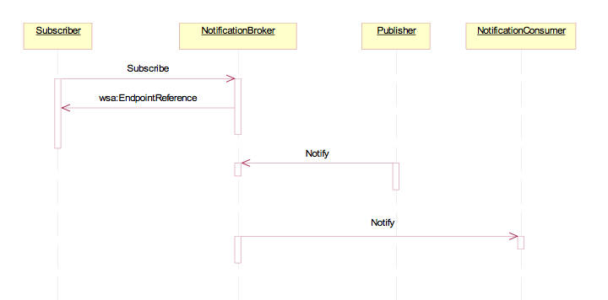
SOAP – WS-Notification
http://www.ibm.com/developerworks/library/ws-pubsub/WS-PubSub.pdf

Slide 19
Callbacks – WS Addressing
WS-Addressing is a standardized way of including message routing data within SOAP headers.
Instead of relying on network-level transport to convey routing information, a message utilizing WS-Addressing may contain its own dispatch metadata in a standardized SOAP header.
The network-level transport is only responsible for delivering that message to a dispatcher capable of reading the WS-Addressing metadata. Once that message arrives at the dispatcher specified in the URI, the job of the network-level transport is done.

Slide 20
Callbacks – WS Addressing – Endpoint Reference
An endpoint reference (EPR) is an XML structure encapsulating information useful for addressing a message to a Web service. This includes the destination address of the message, any additional parameters (called reference parameters) necessary to route the message to the destination, and optional metadata (such as WSDL or WS-Policy) about the service.
Message addressing properties communicate addressing information relating to the delivery of a message to a Web service:
Message destination URI
Source endpoint -- the endpoint of the service that dispatched this message (EPR)
Reply endpoint -- the endpoint to which reply messages should be dispatched (EPR)
Fault endpoint -- the endpoint to which fault messages should be dispatched (EPR)
Action -- an action value indicating the semantics of the message (may assist with routing the message) URI
Unique message ID URI
Relationship to previous messages (A pair of URIs)

Slide 21
Callbacks – WS Addressing – Example
Let us look at the example in git

Slide 22
Web Services: SOAP
Understanding SOAP
http://msdn.microsoft.com/en-us/library/ms995800.aspx
Java SOA CookBook (available on blackboard)
Working with SOAP
http://docs.oracle.com/cd/E19798-01/821-1796/aeqex/index.html
SAML v2.0
http://docs.oasis-open.org/security/saml/v2.0/saml-bindings-2.0-os.pdf

